Slide 1
Stock Portfolio Suggestor
CMPE 285 - Software Engineering Process
Spring 2020
Apoorva Banubakode-013773838 | Aswin Prasad-014344512
Duvvuri Venkata Sai Sri Hari -014533571 | Shubhangi Yadav - 014517412
Sruthi Duvvuri - 014528813 | Vamsi Chakravartula - 014488487

Slide 2
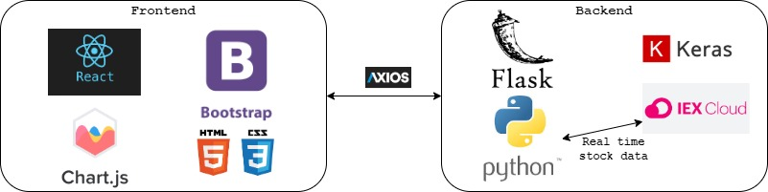
Architecture Overview

Slide 3
Features
Basic Functionalities:
Investment Strategies: User can select one or two investment strategies from Ethical, Growth, Index, Quality & Value strategies.
Investment: User can input the total amount he wants to invest in the strategies he selected.
Stock Suggestions: User will be suggested with top-3 stocks that he can invest into on the basis of strategies he selected.
Amount Distribution: Investment amount is distributed among three suggested companies in the ratio of 2:1:1.
Overall Portfolio: User is provided with current stock & ETF values.
Trend of Portfolio Value: History of overall portfolio value is shown to user.
Hosting: Deployment of application on AWS cloud.
Extra Functionalities:
Machine learning model to predict stock for suggestions.
IEX stock API to get real-time stock data.
Chart js library for data visualization through graphs.
Bootstrap libraries for fancy UI.

Slide 4
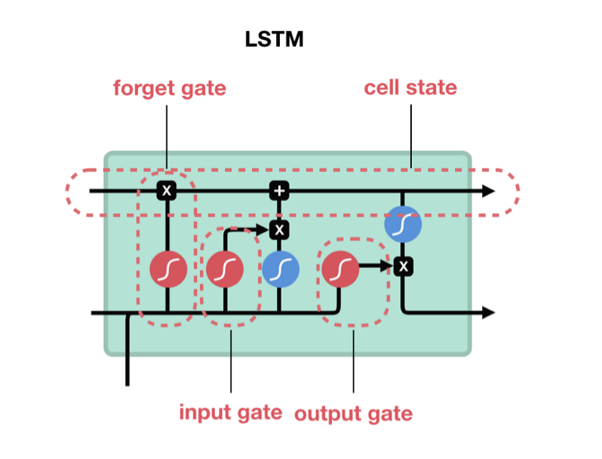
Stock Suggestion Engine (Long Short Term Memory model)
The idea is to suggest stocks under given strategy which are likely to perform better in the next 30 days.
How do we know which stocks are likely to perform better? We used Deep learning model to forecast prices for next 30 days for all stocks.
Model Used : Long Short Term Memory model : It uses 3 gates, forget, input and output to map a combination of features and remember some parametric details of past for the next sequential prediction.
Parameters tuned : 10 epocs, 0.2 dropout rate to avoid overfitting, ‘Relu’ as activation function, ‘adam’ optimizer and mean squared loss as loss function. The model is trained on 80 percent of data for every stock. Inherently the model tries to learn fortnightly stock values and project next day stock prices, for 30 days.
After we predict the stock prices using above model, we looked at the difference of (30th day predicted value-last real stock value) and created a list of companies in descending order of stock difference.
Basically, that means pick up companies who are likely to increase in stock price above other companies in an comparative manner.

Slide 5
Unit Test Cases
Test Case ID | Input | Expected Output
1 | Invest $2000 and one strategy type. | Dialog alerting user to enter any amount >= 5000 is displayed.
2 | $5000 is Invested in three strategies. | An error message to select one or two strategies is displayed.
3 | No amount is entered and press on next | Enter amount dialogue is displayed.
4 | Amount of $5000 is provided and no strategy selected | Dialogue to select strategy is displayed.
5 | Invest $6000 in ethical strategy. | Display a report with distribution of stocks among the selected stocks, graphical stock portfolio for the week along with percent investment on each one.
6 | Invest $5000 in growth strategy. | Display a report with distribution of stocks among the selected stocks, graphical stock portfolio for the week along with percent investment on each one.
7 | Invest $5000 in index strategy. | Display a report with distribution of stocks among the selected stocks, graphical stock portfolio for the week along with percent investment on each one.
8 | Invest $5000 in quality strategy. | Display a report with distribution of stocks among the selected stocks, graphical stock portfolio for the week along with percent investment on each one.
9 | Invest $5000 in value strategy. | Display a report with distribution of stocks among the selected stocks, graphical stock portfolio for the week along with percent investment on each one.
10 | Invest $10000 in quality and ethical strategies. | Display a report with distribution of stocks among the selected stocks, graphical stock portfolio for the week along with percent investment on each one.
11 | Invest $10000 in growth and value strategies. | Display a report with distribution of stocks among the selected stocks, graphical stock portfolio for the week along with percent investment on each one.

Slide 6
Learnings & Challenges
Research on third party API: We as a team directed our efforts in determining the right and appropriate third-party services which will provide us most of the relevant stock data. IEX Cloud API is used for fetching real-time stock data.
Technologies learned & used: We have used various libraries for showing charts, graphs, etc to the user. Flask framework for developing APIs. React.js combined with Bootstrap is used for frontend. Axios library for HTTP request/response. Keras for machine learning data model.
Decisions: Mapping of various stocks/ETFs to investing strategies. Division of investment amount into suggested stocks.

